Slide 1
Time Series Modelling
Apple Stock Price Prediction

Slide 2
Overview
Using Apple Stock Price Dataset we’re going to Work with ARIMA and SARIMAX model
and checking which is efficient

Slide 3

Data Analyzed
Data is Provided by Yahoo Finance and represents
Apple Stock Price byOpen,High,Low,Close,Adj Close
and Volumes for the period Jan 2020 to Dec 2022.
Indicating 736 Records.

Slide 4
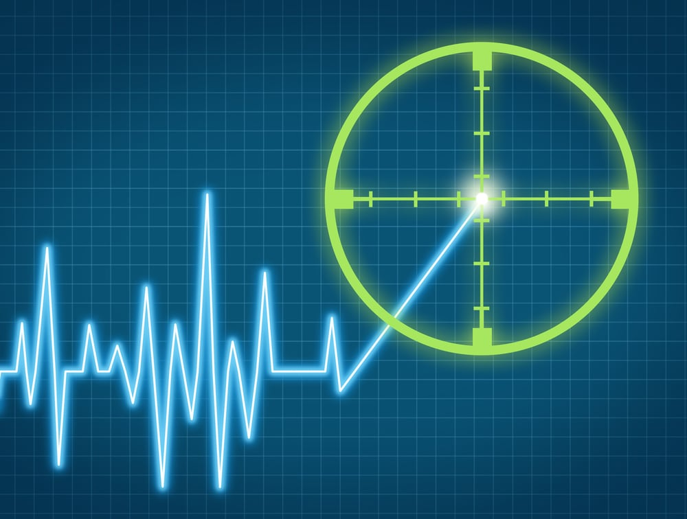
Target
To Find the Efficient Model for the Given
Apple Stock Price Dataset

Slide 5
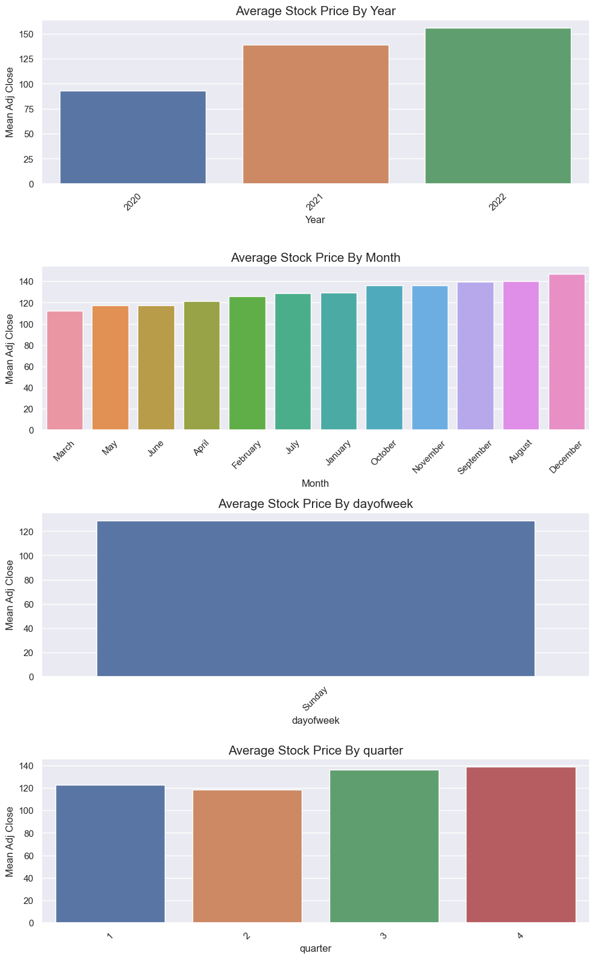
By Taking the Mean of Adj Close we can see that
the Mean price of the year 2020 is less compared
to 2021 and 2022.
The Average Price of the month December is
High because of the Holiday Season.
This also explains that the Quadrant 4 (Oct-Dec)
Is best to buy Apple Stock According to the Mean
Of Adj Close.

Slide 6
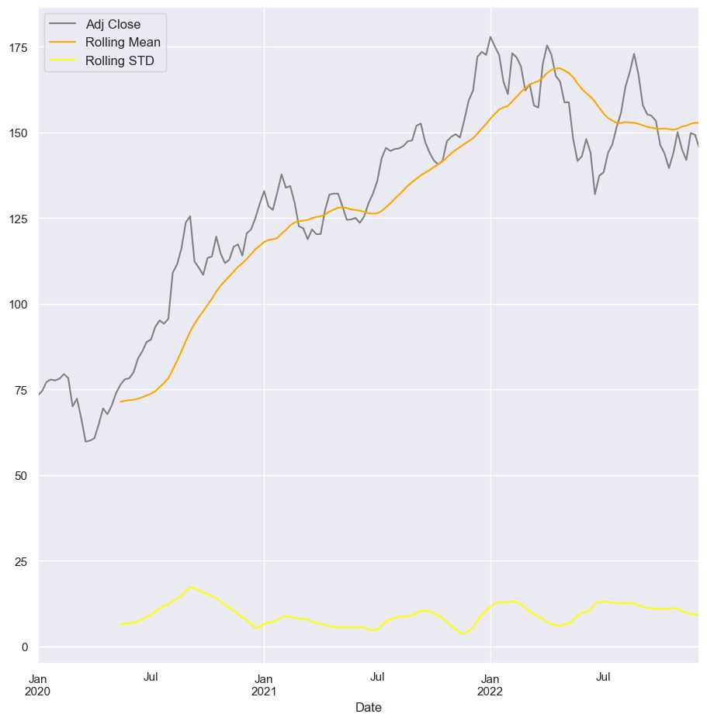
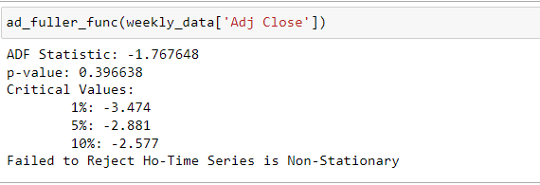
By Visualizing the Adj Close of Weekly Data
we can say that the series is not stationary.
Since its mean and variance are not constant.
This was also Confirmed by Dickey-Fuller Test.
Let us difference our data by 1 to make it
stationary

Slide 7
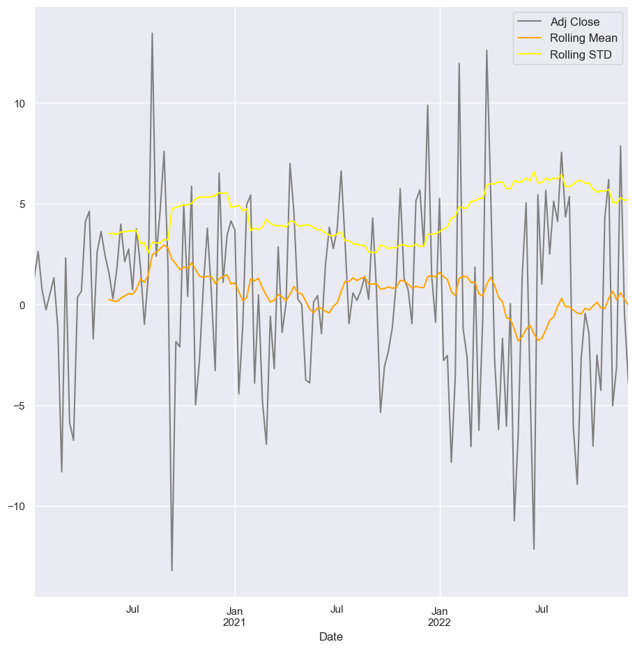
After Differencing Our Weekly Data by 1.We can see
that this Data is Stationary since it has Constant Mean
and Variance.

Slide 8

After Finishing Hyper Parameter Tuning for our model we got our
P=2,d=1,q=1.Non-Seasonal Order as (2,1,1) and Seasonal Order as (0,1,2,12).

Slide 9
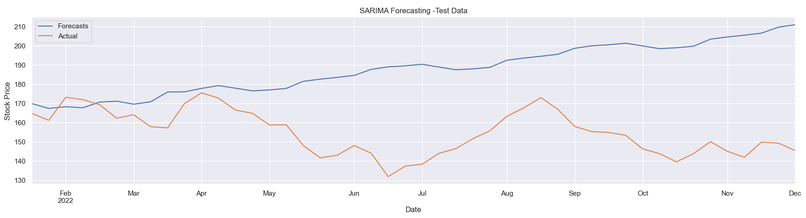
Using SARIMAX Forecasting,I was able to model Apple’s weekly Adj Close Price with an average weekly % error of
22.2% for the Testing Data
MSE: 1498.5320776815433
MAE: 33.01133763623901
RMSE: 38.71087802777849
MAPE: 0.22235280451712344
with MAPE 22.2%, we have accuracy 77.8%.

Slide 10
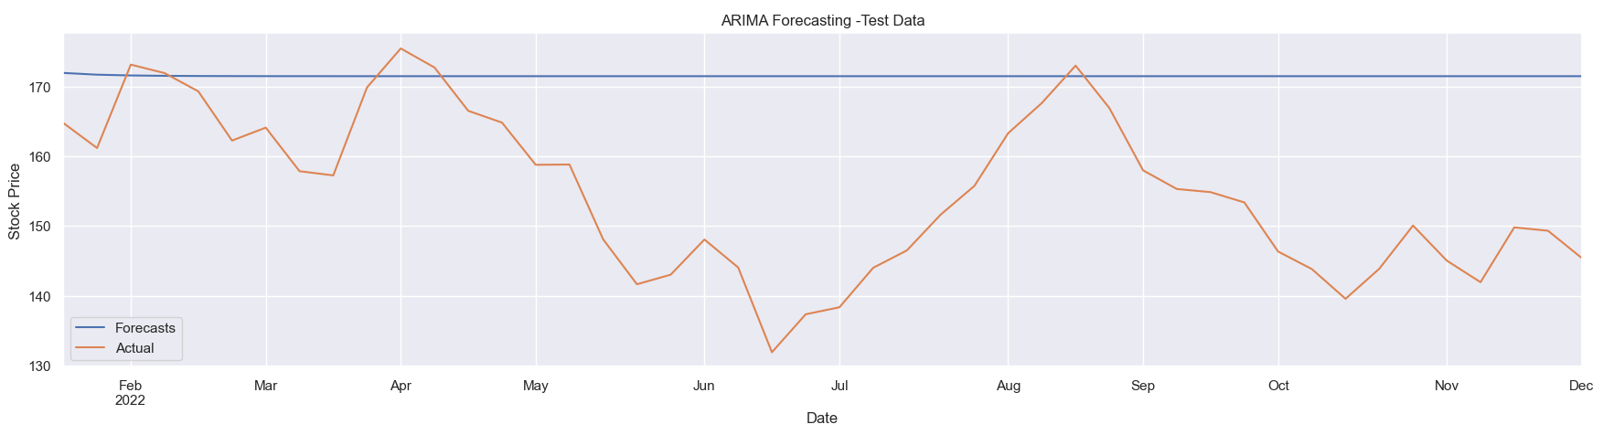
Using SARIMAX Forecasting,I was able to model Apple’s weekly Adj Close Price with an average weekly % error of 11.5% for the Testing Data
MSE: 401.75554164030984
MAE: 16.93749919234568
RMSE: 20.04384049129083
MAPE: 0.11496171456445428
with MAPE 11.5%, we have accuracy 88.5%.

Slide 11
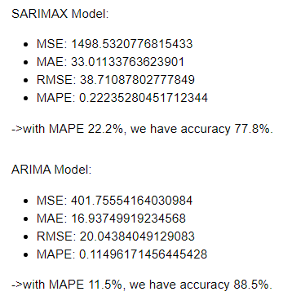
Conclusion
By Looking the MAPE values of both the ARIMA and SARIMAX .
We can conclude that ARIMA Model is Efficient for our data .

